Slide 1
Spring - Introduction

Slide 2
Spring – What ?
A framework that provides comprehensive infrastructural support for developing enterprise Java applications
Spring does all the plumbing, letting developers focus on business code

Slide 3
Goal of Spring framework – DRY SOCKS
DRY – Don’t Repeat Yourself
SOCS – Separation of Concerns

Slide 4
Spring Support
Core Support - Application Configuration, Testing, Data Access
Web application Development – Struts ,JSF Integration, Spring MVC, Spring Webflow, Spring Javascript
Enterprise Application Development – Webservices, Messaging, Manageability, Security

Slide 5
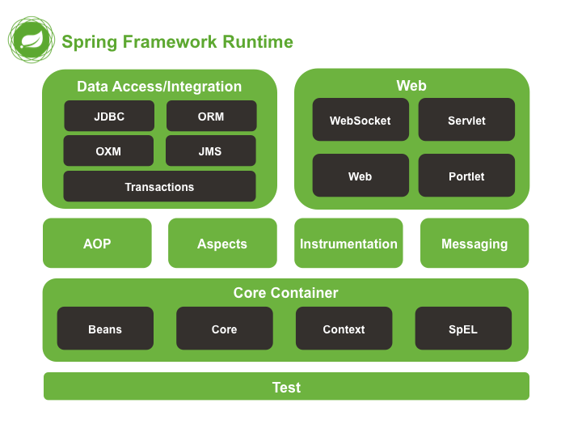
Modules

Slide 6
POJO decorated
Enterprise services non-invasively applied to POJOs
Examples
Make a Java method execute in a database transaction without having to deal with transaction APIs.
Make a local Java method a remote procedure without having to deal with remote APIs.
Make a local Java method a management operation without having to deal with JMX APIs.
Make a local Java method a message handler without having to deal with JMS APIs.

Slide 7
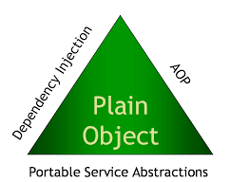
Spring Triangle

